Slide 1


Sign Language Detection
Revolutionizing Communication Through Technology

Slide 2
Name : Jethava Darshan
Enrollment No. : 12102040501010
Branch : Computer Engineering
Project Guide :
Dr. Kinjal Joshi
Department of Computer Engineering

Slide 3
Outlines
Project Definition
Key Features
Possible Application
About Dataset
Model Training
Result

Slide 4
Project Definition
The communication barrier between individuals who rely on sign language and those who do not poses a significant challenge in various aspects of daily life. Traditional methods of bridging this gap, such as interpreters or written communication, are often inefficient or impractical, particularly in real-time interactions.
Consequently, there is a pressing need for an automated system that can recognize and interpret sign language gestures in real-time, facilitating seamless communication between individuals regardless of their ability to understand sign language.

Slide 5
Key Features
Real Time Detection
Implement a real-time detection pipeline that continuously captures video frames from the camera feed.
Apply the same preprocessing steps used during training to each frame in real-time, including resizing, normalization, and noise reduction.
Gesture Interpretation
Handle ambiguous or unrecognized gestures gracefully, providing feedback or suggestions to the user to improve communication effectiveness

Slide 6
Possible Applications
Accessibility:
Sign language recognition can enhance accessibility for deaf and hard-of-hearing individuals by providing real-time translation of sign language into text or spoken language. This can facilitate communication in educational settings, workplaces, public services, and social interactions.
Education:
Sign language recognition can be integrated into educational tools and platforms to assist deaf students in learning and understanding various subjects. It can provide subtitles or translations of lectures, presentations, and educational videos in real-time.

Slide 7
Possible Applications
Communication Devices:
Incorporating sign language recognition into communication devices such as smartphones and tablets enables deaf individuals to communicate more effectively with people who do not understand sign language. This technology can facilitate video calls, messaging, and social media interactions.
Interpreter Support:
Sign language recognition can assist human interpreters by providing real-time transcription or translation of signed content into spoken language or text. This can improve the efficiency and accuracy of interpretation services in settings such as conferences, meetings, and public events.

Slide 8
About Dataset
The dataset contains data(images) of all the alphabets.
Images are of 300x300 px.
Number of images captured for each alphabets are 150.
We have applied preprocessing techniques in dataset such as resizing, cropping, and normalization to standardize the data and reduce variability.

Slide 9
About Dataset
https://www.kaggle.com/datasets/datamunge/sign-language-mnist (2017)
https://ieee-dataport.org/documents/sign-language-correctness-discrimination-slcd-dataset (2023)
https://public.roboflow.com/object-detection/american-sign-language-letters (2022)

Slide 10
Model Training
Split the preprocessed dataset into training, validation, and possibly test sets using appropriate data splitting strategies (e.g., stratified sampling).
Choose a suitable machine learning or deep learning architecture for the task, such as convolutional neural networks (CNNs) known for their effectiveness in image classification tasks.

Slide 11
Model Training
Modules used in the model training process :
OpenCV
TensorFlow
Keras
Numpy

Slide 12
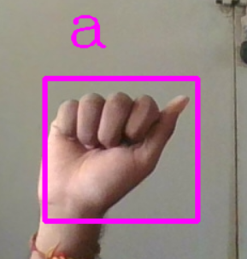
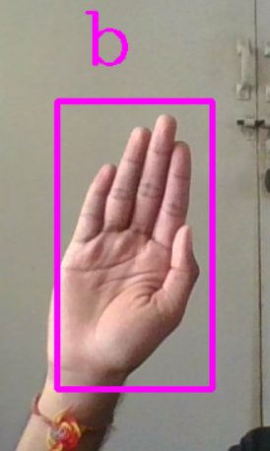
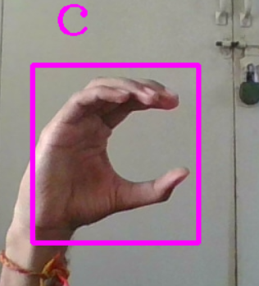
Result
a
b
c

Slide 13
Future Work
Real Time Data Collection
Caption Generation
Speech Generation

Slide 14
References
Sign Language Recognition - Justin Chen (Stanford University) (2023)
MIE324 Final Report: Sign Language Recognition – Anna Deza and Danial Hasan (2018)
Realtime Sign Language Detection and Recognition - IEEE (2022)
Sign Language Recognition using Machine Learning - IEEE (2022)

Slide 15
Q&A

Slide 16
Thank you

